Slide 1


Advanced HTML5
New Markups & APIs

Slide 2

HTML5 - New APIs
Course objectives
By completing this course, you will be able to:
Make accessible widgets thanks to ARIA
Structure your data markup with Microdatas
Use Drag & Drop features in your web apps
Geolocalize a user of your web apps

Slide 3

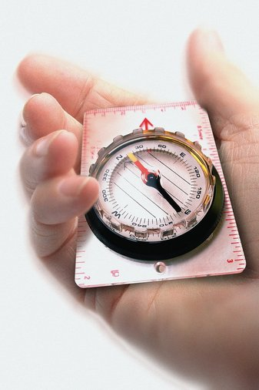
HTML5 - New APIs
Course topics
Course’s plan:
ARIA
Microdata
Drag & Drop
Geolocation

Slide 4

ARIA
Advanced HTML5

Slide 5

ARIA
Introduction to widgets
HTML has native support for only a few user interface controls
Links and form elements
More and more webapps use widgets
More complex controls
Combination of HTML elements and script

Slide 6
ARIA
Introduction to widgets
A control have:
A role (purpose)
Properties (state)
A script can change them on native HTML elements in order to create custom widgets

Slide 7
ARIA
Introduction to widgets
For example, look at the following HTML code :
With some styles and scripts, we can transform those elements into a widget
<div id="tb-1" class="toolbar">
<button type="button">Print</button>
<button type="button">Move</button>
<button type="button">Delete</button>
</div>

Slide 8
ARIA
Introduction to widgets
Other example:
<ul class="tree">
<li class="treeitem">Item 1</li>
<li class="presentation">
<a href="#group-1" class="treeitem">Item 2</a>
<ul class="group">
<li class="treeitem">Item 2-1</li>
<li class="treeitem">Item 2-2</li>
</ul>
</li>
</ul>

Slide 9
ARIA
Widget & Accessibility
We saw how to write HTML by using the proper semantic elements and attributes
Necessary in order to expose element semantics to assistive technology
But how to exposed widgets to these technology ?

Slide 10

ARIA
Widget & Accessibility
W3C addressed this issue in Web Content Accessibility Guidelines (WCAG) 2.0
With the ARIA specification !

Slide 11
ARIA
Accessibility with ARIA
ARIA for Accessible Rich Internet Applications
W3C specification to improve the accessibility of custom widgets
Focus on dynamic content and UI components
Ajax, HTML, JavaScript and related technologies

Slide 12
ARIA
Accessibility with ARIA
Provides additional semantics beyond what is available in current implementations of HTML
Bridging technology filling gaps between versions of the HTML specs
Neither HTML 4 or 5 provide a toolbar or dialog widget, but both can be declared using ARIA

Slide 13
ARIA
Role attribute
For example, our previous toolbar can be declared like that:
<div id="tb-1" role="toolbar">
<button type="button">Print</button>
<button type="button">Move</button>
<button type="button">Delete</button>
</div>

Slide 14
ARIA
Role attribute
The role attribute document the purpose of the control
Can only be set to one of several predefined values
When building custom widgets always start with the closest native semantics and supplement with ARIA

Slide 15
ARIA
Role attribute: Widget Roles
The following roles act as standalone UI widgets or as part of composite widgets :
alert
alertdialog
button
checkbox
dialog
gridcell
link
marquee
menuitem
menuitemcheckbox
menuitemradio
option
progressbar
radio
scrollbar
slider
spinbutton
status
tab
tabpanel
textbox
timer
tooltip
treeitem

Slide 16
ARIA
Role attribute: Document Structure
The following roles describe structures that organize content in a page
Document structures are not usually interactive
article
columnheader
definition
directory
document
group
heading
img
list
listitem
math
note
presentation
region
row
rowheader
separator
toolbar

Slide 17
ARIA
Role attribute
Other example:
<ul role="tree">
<li role="treeitem">Item 1</li>
<li role="presentation">
<a href="#group-1" role="treeitem">Item 2</a>
<ul role="group">
<li role="treeitem">Item 2-1</li>
<li role="treeitem">Item 2-2</li>
</ul>
</li>
</ul>

Slide 18
<figure role="img" aria-labelledby="fish-caption">
<pre>
o .'`/
' / (
O .-'` ` `'-._ .')
_/ (o) '. .' /
) ))) >< <
`\ |_\ _.' '. \
'-._ _ .-' '.)
jgs `\__\
</pre>
<figcaption id="fish-caption">
Joan G. Stark, "<cite>fish</cite>".
</figcaption>
</figure>
Other example:
Other example
Notes:
ASCII art, which is really an image, appears to be text, and in the absence of appropriate annotations would end up being rendered by screen readers as a very painful reading of lots of punctuation. Using ARIA features, one can instead make the ATs skip the ASCII art and just read the caption.

Slide 19
ARIA
ARIA attributes
As you can see in the last example, ARIA widgets can have attributes
ARIA attributes are always prefixed by "aria-"
<ul role="tree" aria-multiselectable="true">...</ul>

Slide 20
ARIA
ARIA attributes
ARIA attributes can be :
States
Properties
Some available attributes:
aria-autocomplete
aria-checked
aria-describedby
aria-disabled
aria-haspopup
aria-label
aria-labelledby
aria-selected
…
Notes:
All the ARIA attributes are available here: http://www.w3.org/TR/wai-aria/states_and_properties

Slide 21
ARIA
ARIA attributes
Three ways to label a widget :
<label> element
<label for="male">Male</label>
<input type="radio" name="sex" id="male" />

Slide 22
ARIA
ARIA attributes
Three ways to label a widget :
aria-label attribute
<input type="checkbox" aria-label="Message 1"
title="Click to select this message" />

Slide 23
ARIA
ARIA attributes
Three ways to label a widget :
aria-labelledby attribute
<div role="alertdialog" aria-labelledby="hd">
<form>
<fieldset>
<legend id="hd">Confirm Action</legend>
<p>Are you sure you want to submit this form?</p>
<input type="button" value="OK"> ...
</fieldset>
</form>
</div>

Slide 24
ARIA
Styling States and Properties
ARIA widgets states and properties are unmanaged
Developers are responsible for defining the visual style associated with widget states and properties
In order to do that, you can use CSS Attribute Selectors using ARIA attributes

Slide 25
ARIA
Styling States and Properties
Example:
a[aria-expanded=true] + ul[role=group] {
display: block;
}
a[aria-expanded=false] + ul[role=group] {
display: none;
}

Slide 26


Questions ?

Slide 27
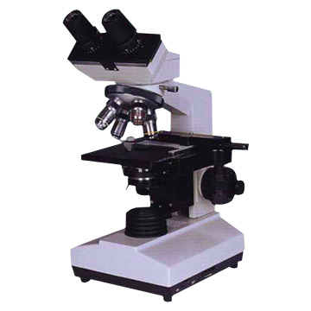
Microdata
Advanced HTML5

Slide 28
Microdata
Presentation
Specification used to nest semantics within existing content on web pages
Used to provide a richer browsing experience for users
Can be extracted and processed by:
Search engines
Web crawlers
Browsers
…

Slide 29
Microdata
Presentation
You can label your content to describe a specific type of information
Articles
Events
Person information
…

Slide 30
Microdata
Presentation
Each information type describes a specific type of item
For example, an event has the properties :
Venue
Starting time
Name
…

Slide 31
Microdata
Presentation
The specification introduces simple attributes in HTML tags:
Assign brief and descriptive names to items and properties
<div itemscope itemtype="http://data-vocabulary.org/Person">
My name is <span itemprop="name">Bob Smith</span> but people call me <span itemprop="nickname">Smithy</span>. Here is my home page:
<a href="http://www.example.com" itemprop="url">
www.example.com
</a>
</div>

Slide 32
Microdata
Attributes
itemscope :
An element with this attribute specified creates a new item, a group of name-value pairs
Elements creating new items may have an itemtype attribute

Slide 33
Microdata
Attributes
itemtype :
A valid URL of a vocabulary that describes the item and its properties context
A collection of commonly used (and Google Supported) vocabularies are located at:
http://www.schema.org

Slide 34
Microdata
Attributes
itemid :
Optional, indicates a unique identifier of the item
<dl itemscope itemtype="http://vocab.example.net/book"
itemid="urn:isbn:0-330-34032-8">
...
</dl>

Slide 35
Microdata
Attributes
itemref :
Properties that are not descendants of the element with the itemscope attribute can be associated with the item using this attribute
Provides a list of element itemids with additional properties elsewhere in the document

Slide 36
Microdata
Attributes
The following snippets are equivalent :
<div itemscope>
<p itemprop="a">1</p>
<p itemprop="a">2</p>
<p itemprop="b">test</p>
</dl>
<div id="x">
<p itemprop="a">1</p>
</div>
<div itemscope itemref="x">
<p itemprop="b">test</p>
<p itemprop="a">2</p>
</div>

Slide 37
Microdata
Attributes
itemprop :
Indicates that its containing tag holds the value of the specified item property
The properties name and value context are described by the item vocabulary

Slide 38
Microdata
Attributes
Example:
<dl itemscope itemtype="http://vocab.example.net/book"
itemid="urn:isbn:0-330-34032-8">
<dt>Title</dt>
<dd itemprop="title">The Reality Dysfunction</dd>
<dt>Author</dt>
<dd itemprop="author">Peter F. Hamilton</dd>
</dl>

Slide 39
Microdata
Rich Snippets Testing Tool
Go to :
http://www.google.com/webmasters/tools/richsnippets
Test some of the provided examples

Slide 40
Questions ?

Slide 41
Microdata
Exercise (1/2)
Let’s design a simple widget: an HTML5 event manager!
Create a form asking some information:
Event:
Name, start date, end date
Location:
City, postal code, box number and street
Use HTML5 new input types & validation attributes

Slide 42
Microdata
Exercise (2/2)
Let’s design a simple widget: an HTML5 event manager!
Display data inside an HTML dialog on submit
Be creative for the design!
Use microdata to each property
Use ARIA role and label on dialog box
Validate your HTML code with W3C validator and Rich Snippet Testing Tool

Slide 43
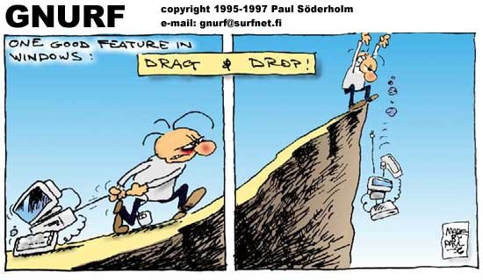
Drag & drop
Advanced HTML5

Slide 44
Drag & Drop
Presentation
Drag and drop is a very common feature
"grab" an object and drag it to a different location
In HTML5, drag and drop is part of the standard, and any element can be draggable

Slide 45
Drag & Drop
Draggable
To make an element draggable is very simple :
Give the element a draggable attribute
Set an event listener for dragstart event
<p>What fruits do you like?</p>
<ol>
<li draggable="true"> Apples </li>
<li draggable="true"> Oranges </li>
<li draggable="true"> Pears </li>
</ol>

Slide 46
Drag & Drop
Draggable
Handler :
var fruits = document.querySelectorAll("li[draggable]");
var fruit = null;
for (var i = 0; i < fruits.length; i++) {
fruit = fruits[i];
fruit.addEventListener("dragstart", function(event) {
console.log("dragstart");
});
};

Slide 47
Drag & Drop
Dropzone
To make an element accept a drop :
Give the element a dropzone attribute
Set an event listener for dragover event and cancel the event
Otherwise, no drop event will be triggered
Set an event listener for drop event

Slide 48
Drag & Drop
Dropzone
Example :
<ol dropzone="move string:text/x-example" ondragover="event.preventDefault()" ondrop="dropHandler(event)">
</ol>

Slide 49
Drag & Drop
Dropzone
The dropzone attribute specifies
What kind of data to accept
string:text/plain
file:image/png
...
What kind of feedback to give
move
copy
…

Slide 50
Drag & Drop
Dropzone
Instead of using the dropzone attribute, you can use :
A dragenter event handler
To report whether or not the drop target is to accept the drop
A dragover event handler
To specify what feedback is to be shown to the user

Slide 51
Drag & Drop
Dropzone
Example:
var zone = document.querySelector("ol[dropzone]");
zone.addEventListener("dragover", function(event) { ... });
zone.addEventListener("dragenter", function(event) { ... });
zone.addEventListener("dragleave", function(event) { ... });
zone.addEventListener("drop", function(event) { ... });

Slide 52
Drag & Drop
Data Transfer
DataTransfer object is used to transfer information from the draggable element to the dropzone
Accessible from the event parameter inside your handlers
fruit.addEventListener("dragstart", function(event) {
var dataTransfer = event.dataTransfer;
});

Slide 53
Drag & Drop
Data Transfer
The two main methods of the DataTransfer interface are :
getData(type)
Retrieves the data for a given type, or an empty string if does not exist
setData(type, data)
Sets the data for a given type

Slide 54
Drag & Drop
Data Transfer - Example
...
fruit.addEventListener("dragstart", function(event) {
event.dataTransfer.setData("text", this.id);
});
...
zone.addEventListener("dragover", function(event) {
event.preventDefault(); // allows us to drop
});
zone.addEventListener("drop", function(event) {
var fruitId = event.dataTransfer.getData("text");
// Append the fruit to the dropzone
});

Slide 55
Questions ?

Slide 56
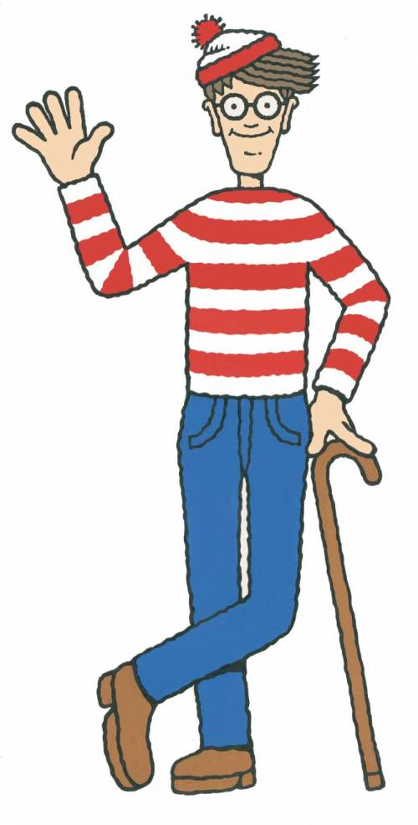
geolocation
Advanced HTML5

Slide 57
Geolocation
Presentation
The new Geolocation API defines a high-level interface to location information
The API itself is agnostic of the underlying location information sources
Can be GPS, location inferred from network signals as well as user input

Slide 58
Geolocation
Presentation
The API is designed to enable
"one-shot" position requests
repeated position updates
Location information is represented by latitude and longitude coordinates

Slide 59
Geolocation
One-shot position request
The Geolocation interface expose the following method to do that:
getCurrentPosition(callback)
The callback function take the user position as argument

Slide 60
Geolocation
One-shot position request
Example :
navigator.geolocation.getCurrentPosition( function(position){
console.log("Latitude: " + position.coords.latitude);
console.log("Longitude: " + position.coords.longitude);
});

Slide 61
Geolocation
Repeated position updates
The Geolocation interface expose also the following methods :
watchPosition(callback, errorHandler)
Request repeated updates and return a watcher ID
clearWatch(watchId)
Cancel the updates for a given watcher ID

Slide 62
Geolocation
Repeated position updates
Example :
var geolocation = navigator.geolocation
, watchId = geolocation.watchPosition(updateLocation, handleError);
function updateLocation(position) { // Do something }
function handleError(error) { // Display an error message }
document.getElementById("cancelButton").onclick = function() {
navigator.geolocation.clearWatch(watchId);
}

Slide 63
Questions ?

Slide 64
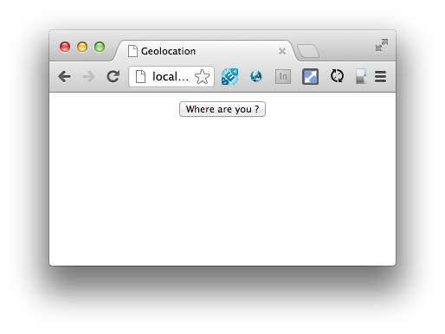
Geolocation
Exercise (1/3)
Create a new page with a simple button as follow :

Slide 65
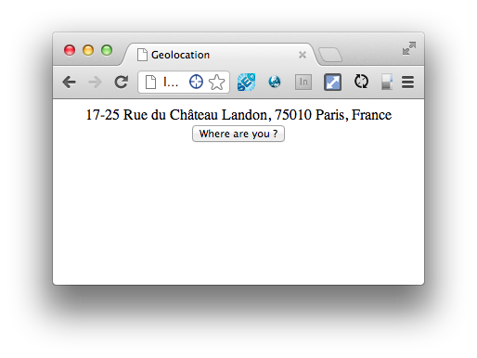
Geolocation
Exercise (2/3)
When the user clicks on the button, you have to display his address :

Slide 66
Geolocation
Exercise (3/3)
To convert coordinates to address, you can use the Google Maps Geocoder API:
https://developers.google.com/maps/documentation/javascript/geocoding

Slide 67


